Slide 1
Raster Datasets
Today’s Agenda
Hand back and review exam
Rasters
Map algebra and Boolean overlay
Other functions
Intro to Sand Table Project

Slide 2
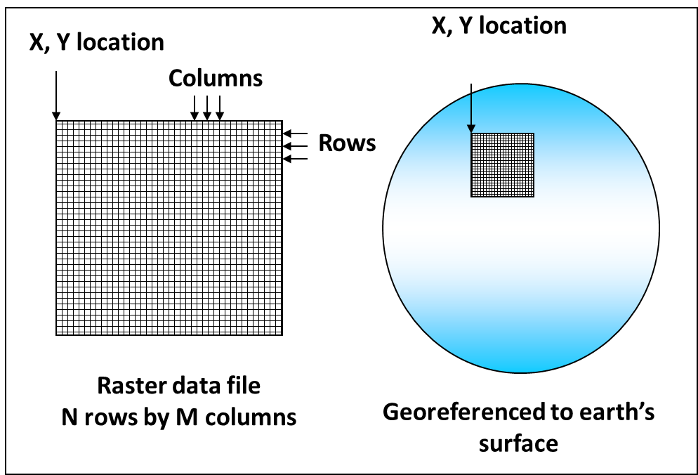
The raster data model
Raster Data Model: A method for representing instances of a field by dividing a space into cells.
Raster data models use a set of cells arranged in a grid pattern
Concepts or phenomena that vary over space

Slide 3
The raster data model
4 key parts:
Number of columns
Number of rows
Origin (easting, northing)
Grid cell size (in ground units)
If you know one cell, you can get the location of any other feature

Slide 4
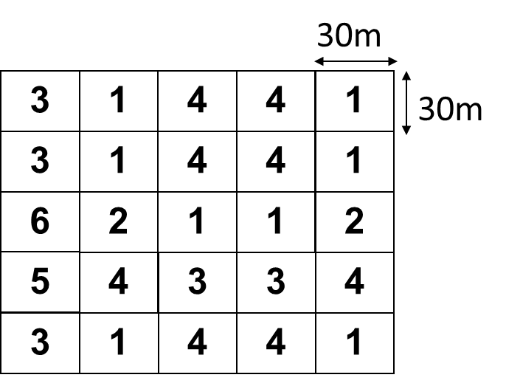
Pixels or Cells
Each pixel contains one numeric value
Dimension of a pixel varies (resolution)
Value represents some property of that pixel area, for example, elevation or rainfall
Unlike a polygon, each cell has only ONE attribute: its value.
Storing multiple values means storing multiple rasters.

Slide 5
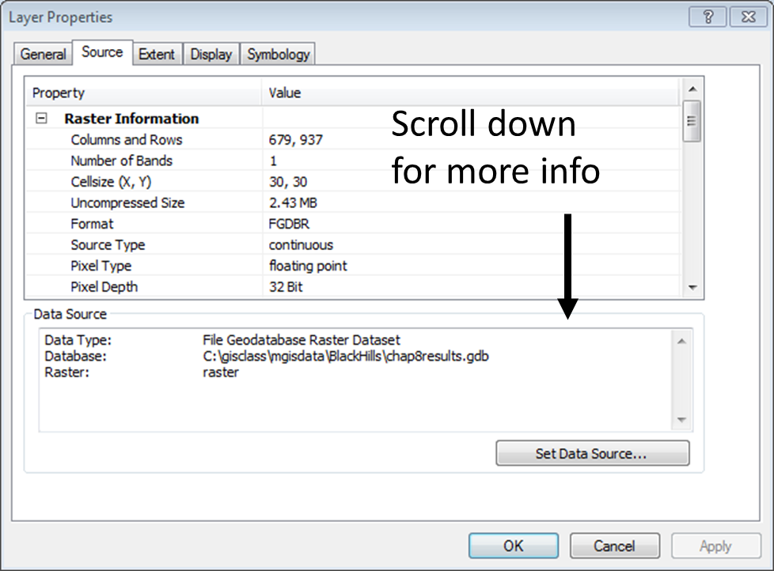
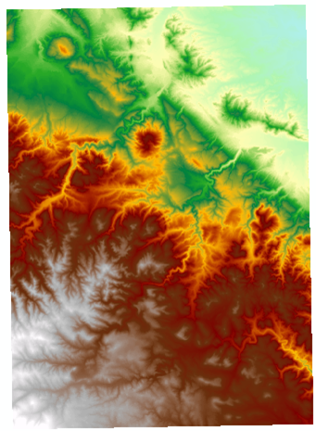
Raster Properties

Slide 6
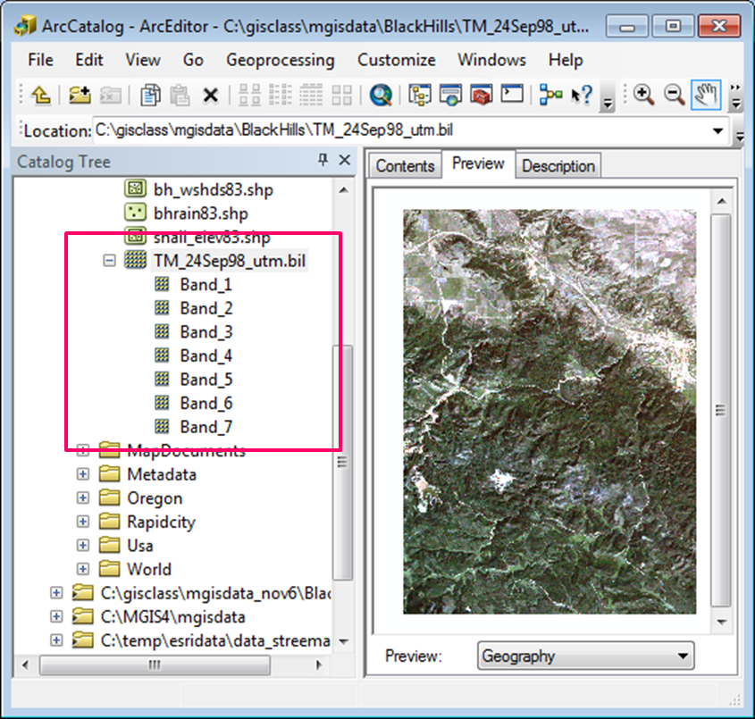
Bands
A single raster may include multiple arrays
Most often used to store color images and satellite images
7-band Landsat satellite image

Slide 7
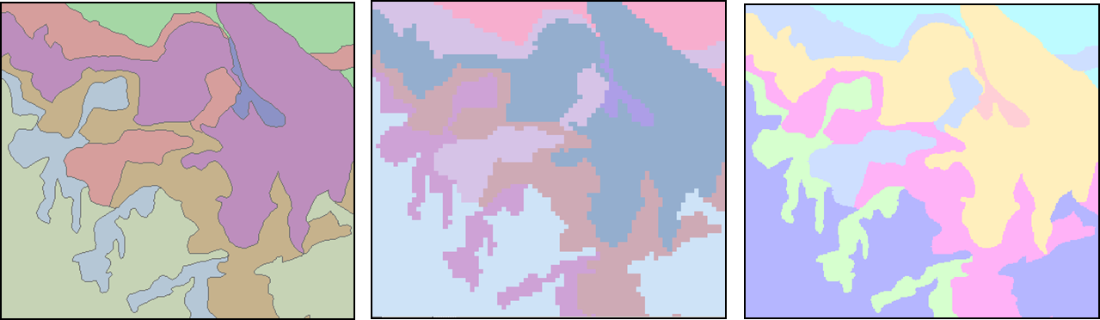
Raster resolution
Measured by cell size dimensions
Storage space increases as the square of the resolution
Vector format
200 m raster
50 m raster
16x bigger!

Slide 8
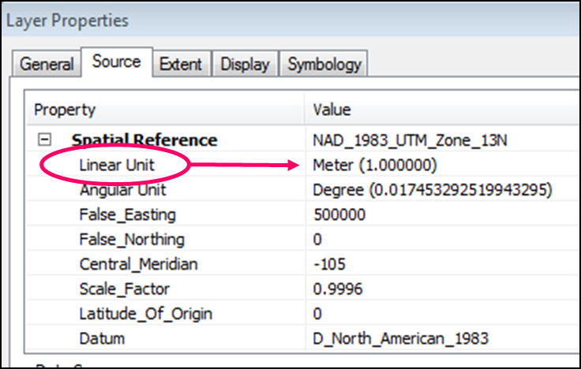
Cell size units
Cell x-y resolution units are based on the raster’s coordinate system definition
Decimal degrees*
Meters
Feet
*Because distances and areas are fundamental to raster analysis, it is best to use projected coordinate systems for rasters.

Slide 9
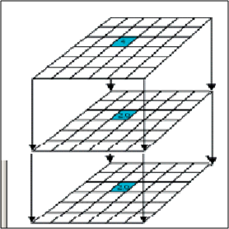
Raster analysis
Raster analysis uses cell-by-cell functions on one or more input grids.
Cells must be the same size and line up spatially.

Slide 10
Raster analysis techniques
Map algebra and Boolean overlay
Other functions

Slide 11
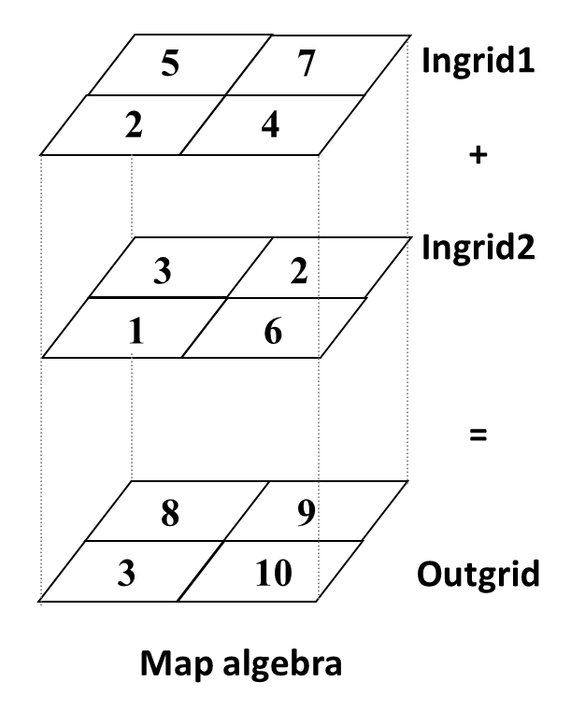
Map Algebra
Rasters are arrays of numbers
Can be added, subtracted, etc.
Line up matching cells vertically

Slide 12
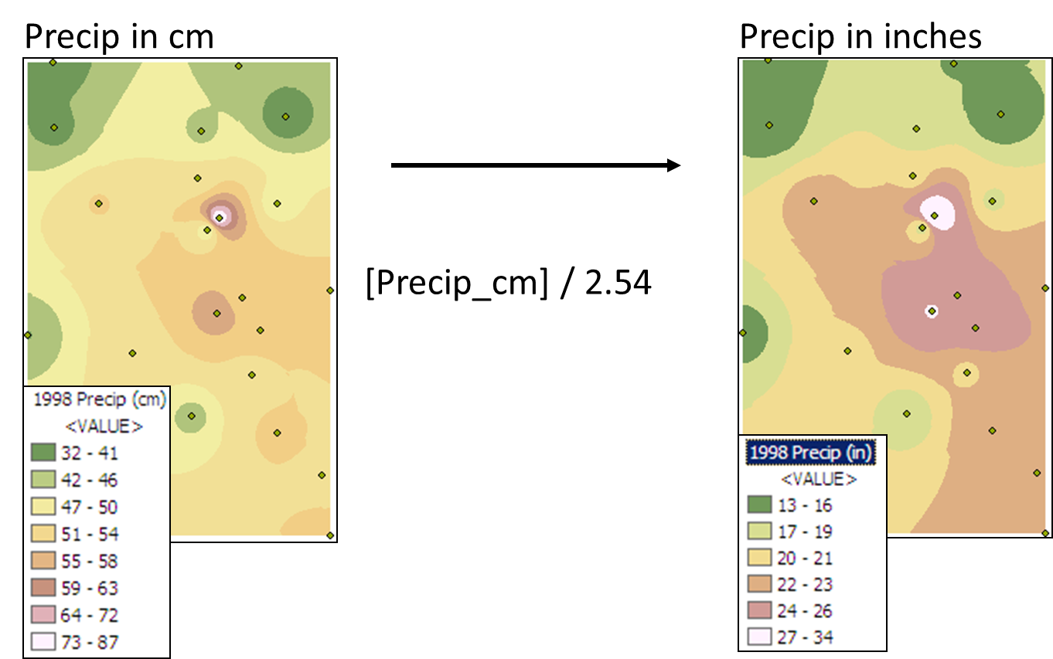
Map Algebra: Conversions

Slide 13
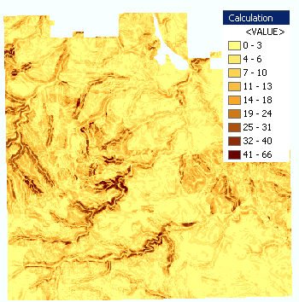
Map Algebra: identify probable locations
Complex expressions with multiple inputs to calcuate risk or hazard index.
Runoff in cm based on four input grids: precip, slope, soil infiltration, and vegetation cover.
[Precip] * 2 + [Slope] * 4 / ( [Erode] – [Vegcover]

Slide 14
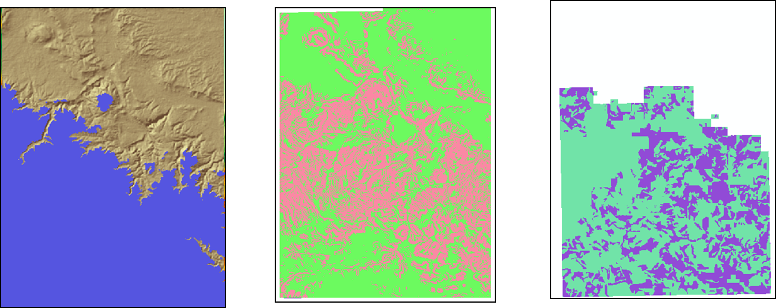
Map Algebra: logical operators
Logical operators produce either TRUE (1) or FALSE (0) values in the output grid, based on whether a cell meets the condition.
[Elevation] > 1200
[Slope] < 10
[crowncov] < 70 AND [crowncov] > 40

Slide 15
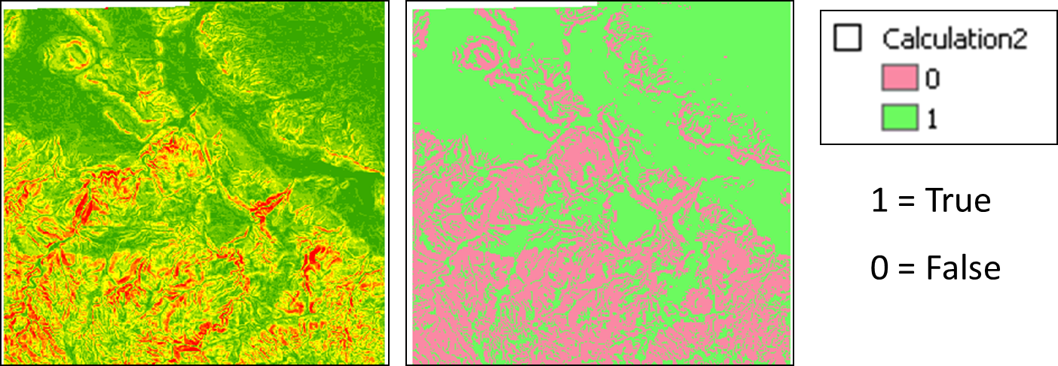
Boolean rasters
Boolean rasters represent maps of True/False states for a particular condition
Slope < 10 degrees?

Slide 16
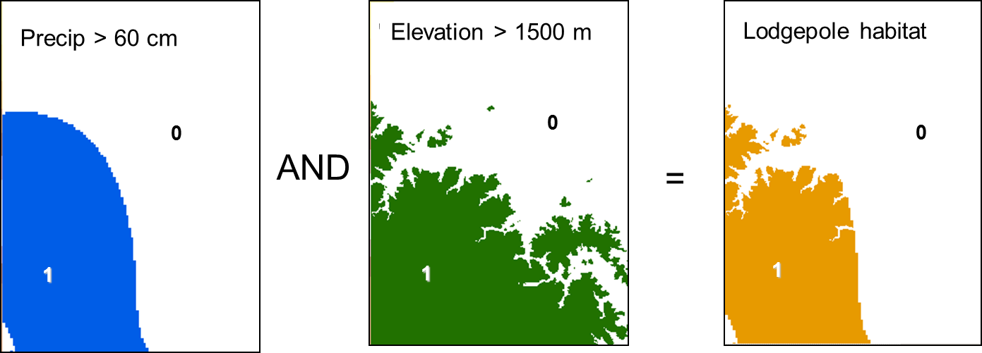
Boolean overlay (AND)
[PrecipGT60] AND [ElevGT1500]

Slide 17
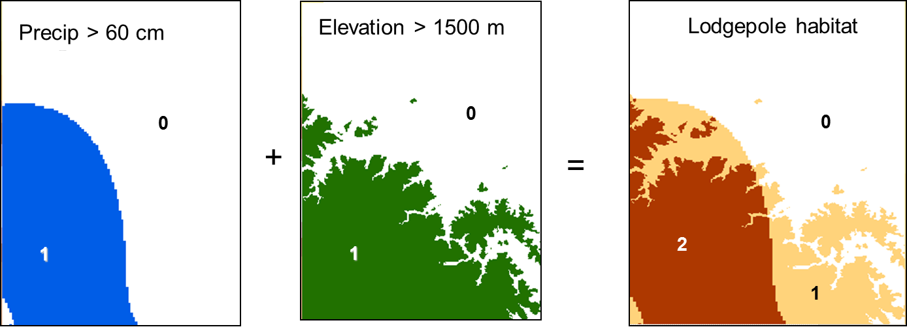
Additive Boolean overlay
ADD the layers together to create a ranked result.

Slide 18
Raster analysis example
Siting a landfill

Slide 19
Landfill raster model
Problem: Find potential locations for a new landfill using these criteria
On flat terrain <= 10 degrees slope
No more than 1 km from an existing road
At least 500 meters from a stream
Meadow or low-density forest
Develop a Boolean raster for each condition with 1 = desirable area, 0 = not desirable area

Slide 20
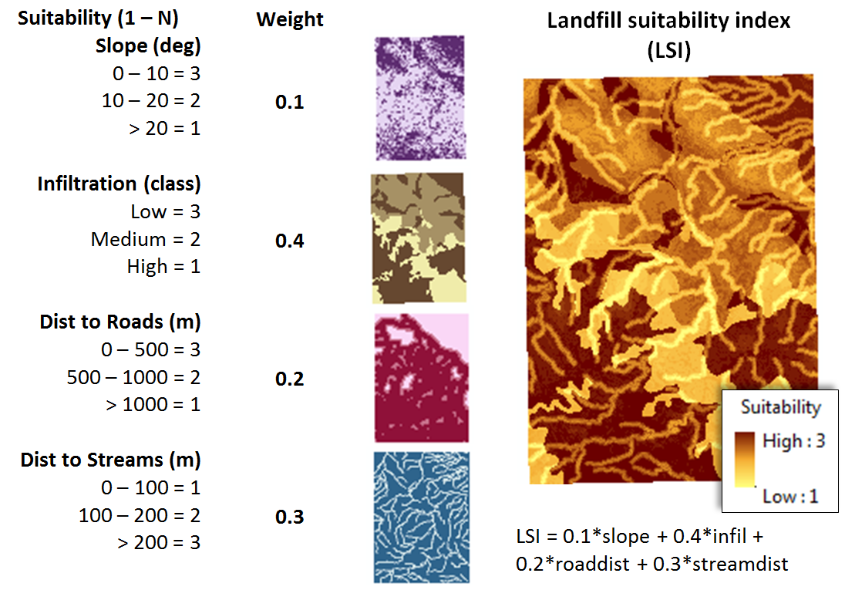
Landfill suitability index (LSI)

Slide 21
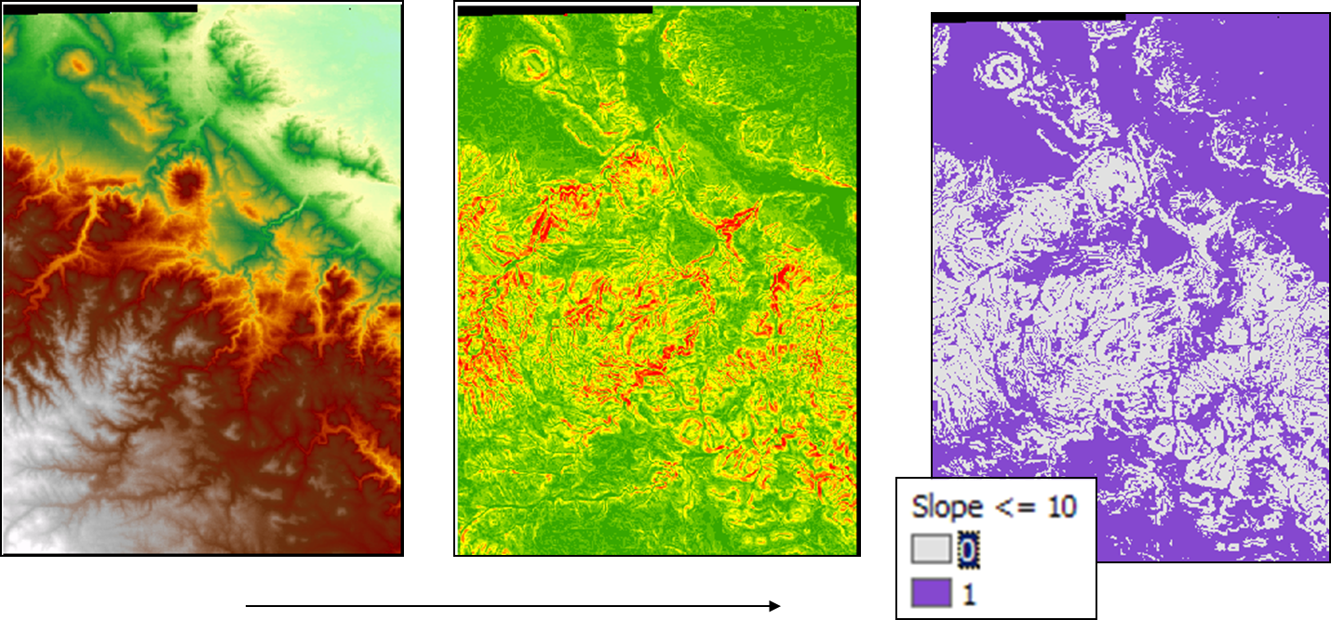
Slope condition
Use slope function on elevation raster.
Use map algebra logical operator to produce Boolean map of slope <= 10 degrees.

Slide 22
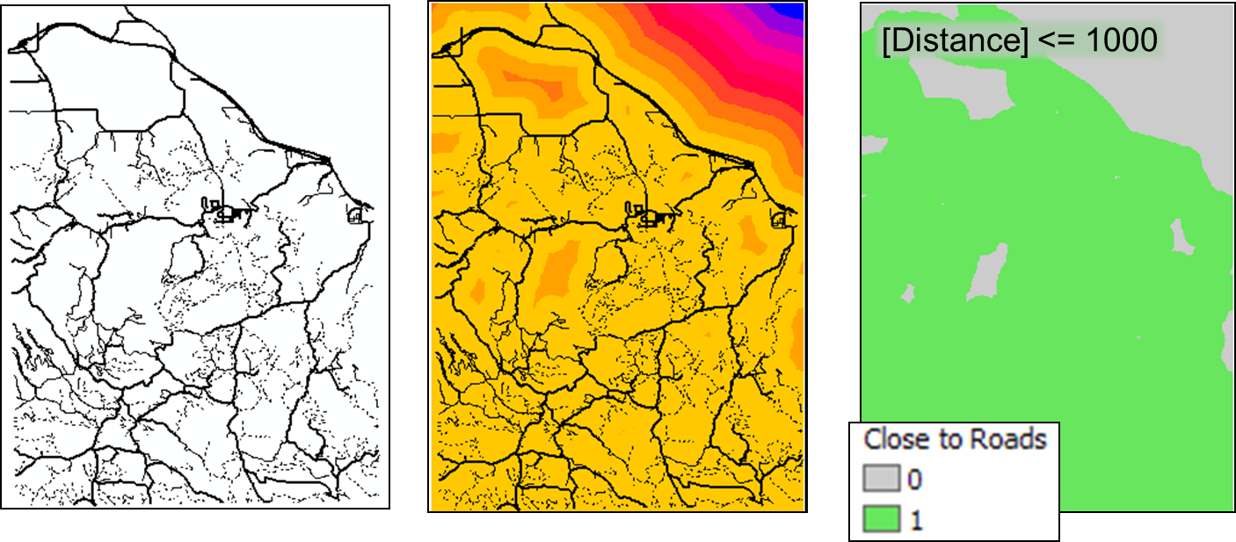
Road distance condition
Use distance function to create raster of distance from roads.
Use logical operator in map algebra to create Boolean raster of areas within 1000 meters of a road.

Slide 23
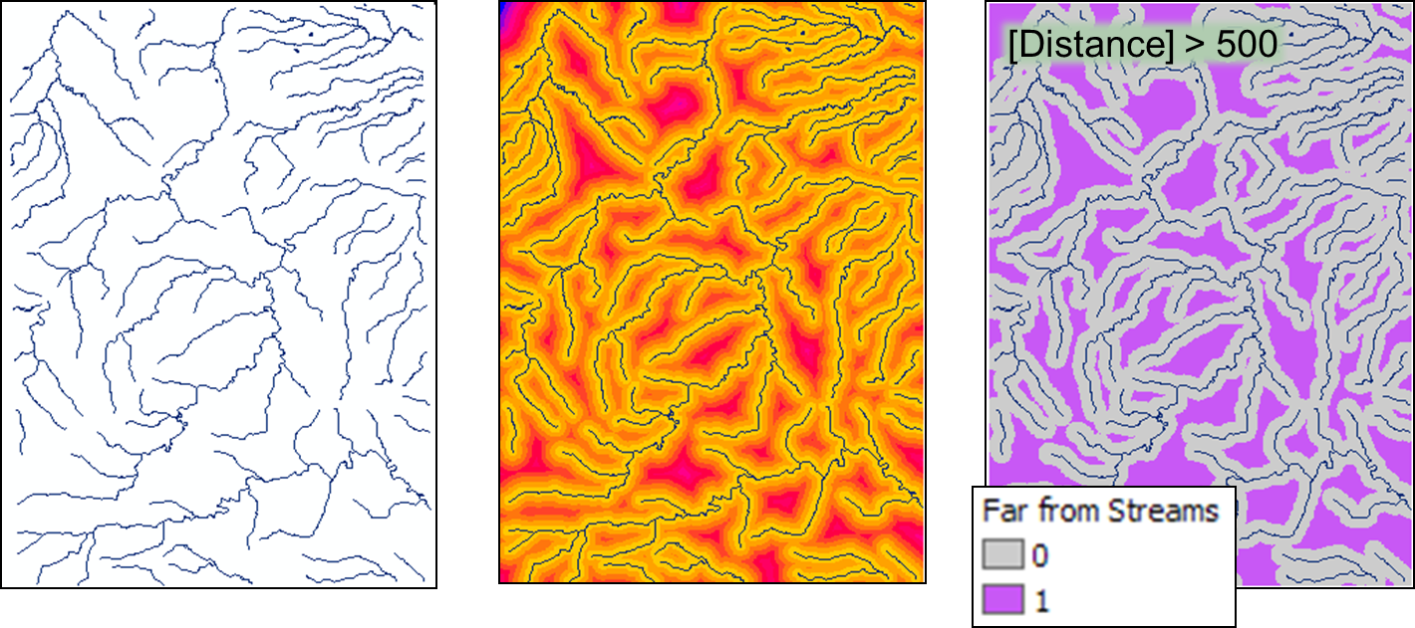
Stream distance condition
Use distance function to create raster of distance from streams.
Use a logical operator in map algebra to create a Boolean map of areas more than 500 meters from a stream.

Slide 24
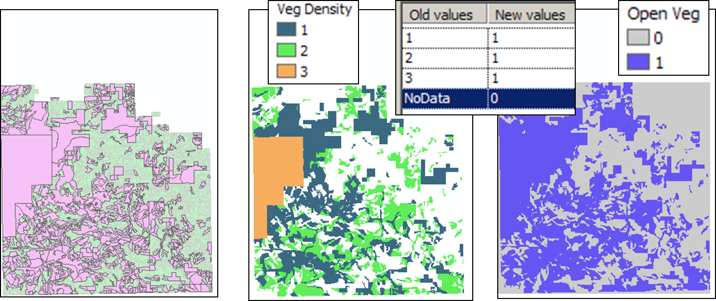
Vegetation condition
Select suitable vegetation density and create a layer from the selected polygons.
Convert the selected vegetation layer to a raster using the density attribute.
Reclassify the three density values all to 1 and the NoData areas to 0.

Slide 25
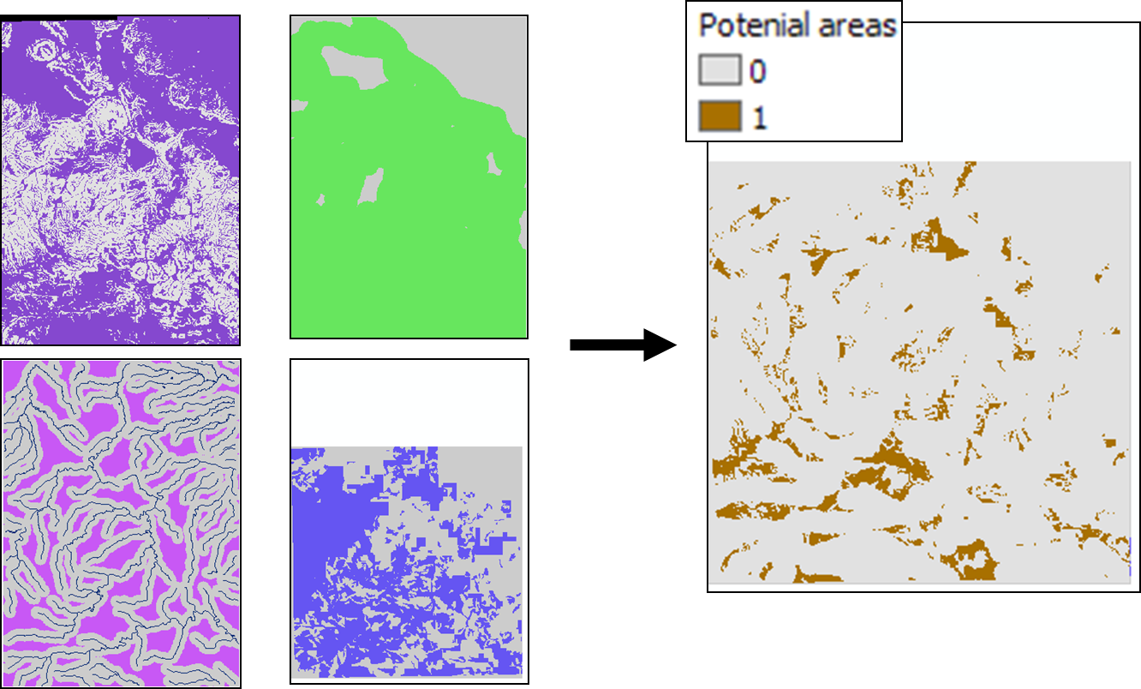
Find landfill areas with Boolean AND
[Slope] AND [Roads] AND [Streams] AND [Vegetation]

Slide 26
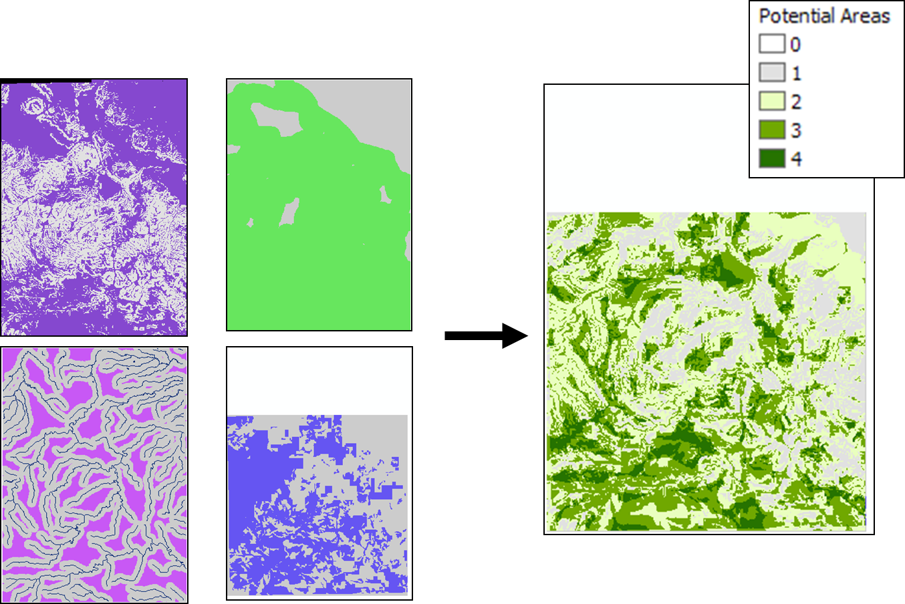
Additive model
Return to Outline
[Slope] + [Roads] + [Streams] + [Vegetation]

Slide 27
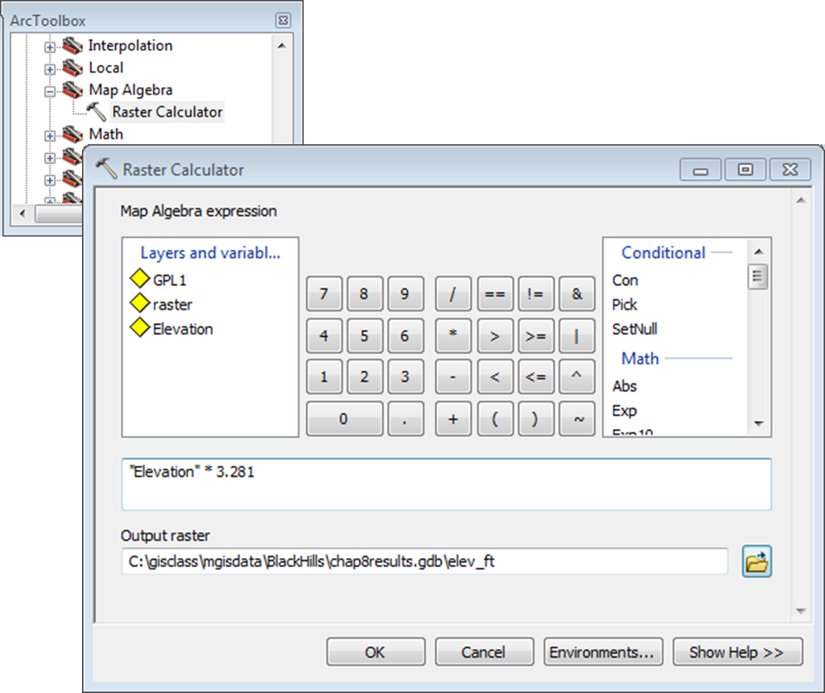
Where do we do these calculations? Raster Calculator
Numeric formulas
Mathematical functions (sin, exp, cos, etc)
Logical operators
Boolean operators

Slide 28
Raster analysis techniques

Slide 29
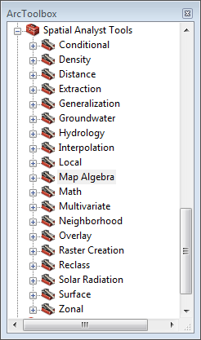
Other raster analysis techniques
Reclassification
Surface functions
Distance functions
Density functions
Interpolation
Neighborhood functions
Zonal functions

Slide 30
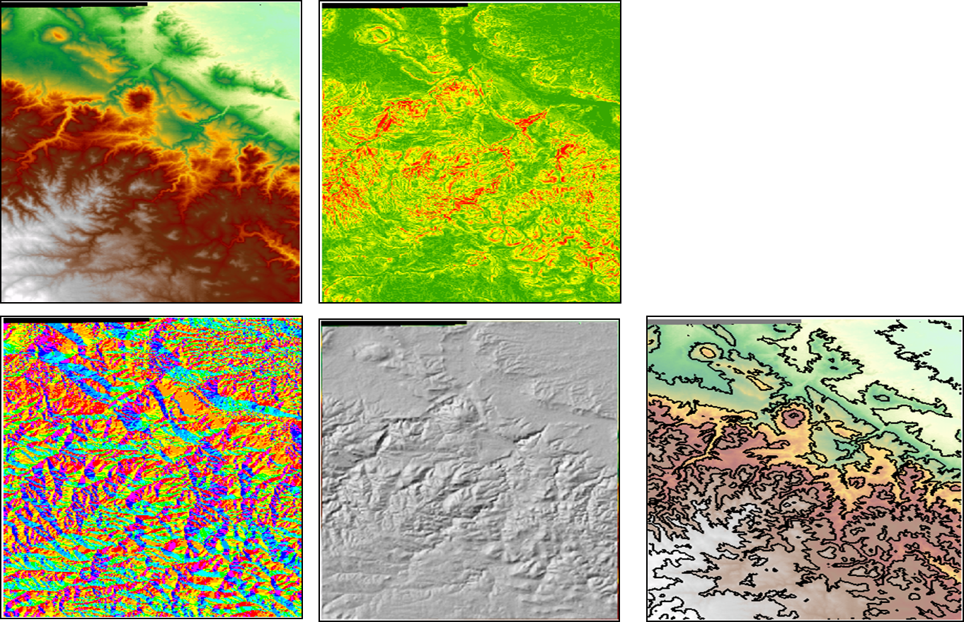
Surface analysis
DEM
Slope
Aspect
Hillshade
Contouring

Slide 31
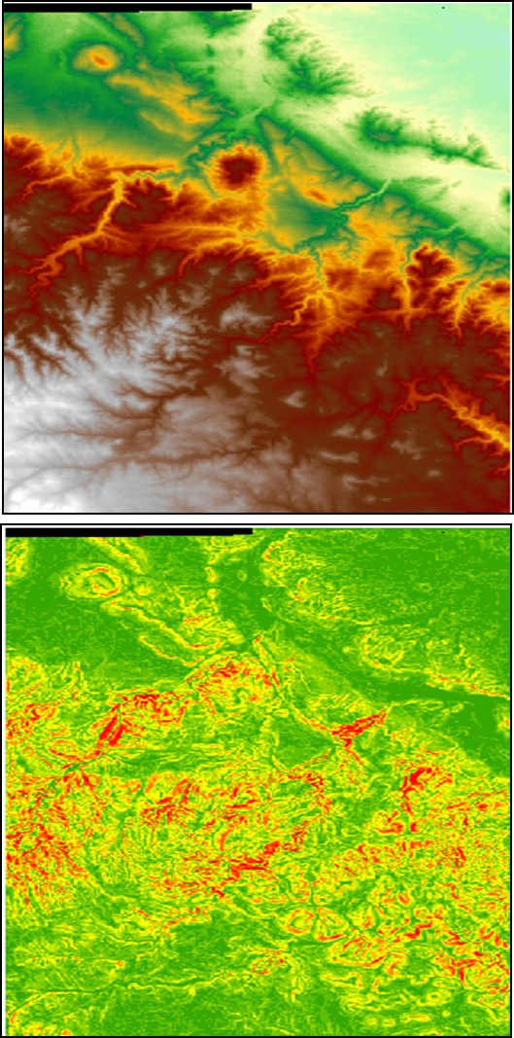
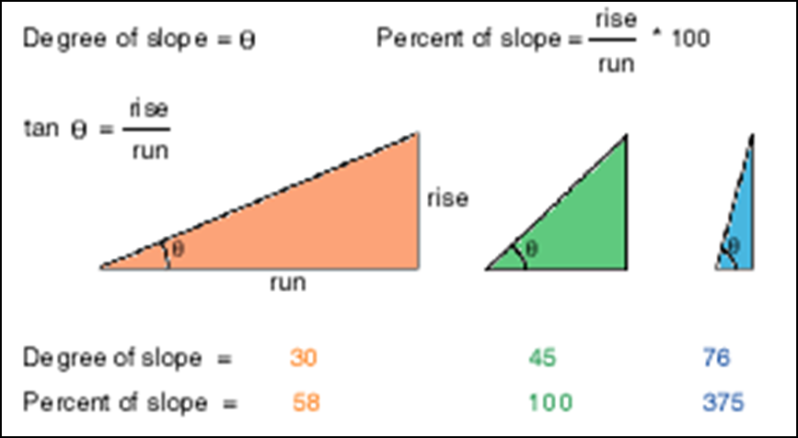
Slope function
Calculates slope of the surface based on surrounding cells. Can be expressed in degrees or percent.
What areas are suitable for a ski resort?

Slide 32
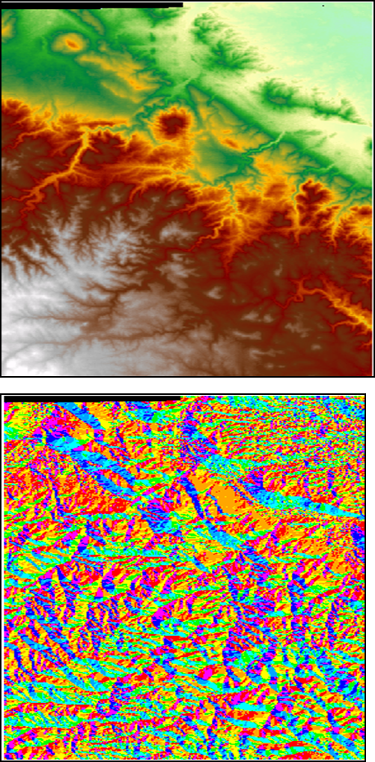
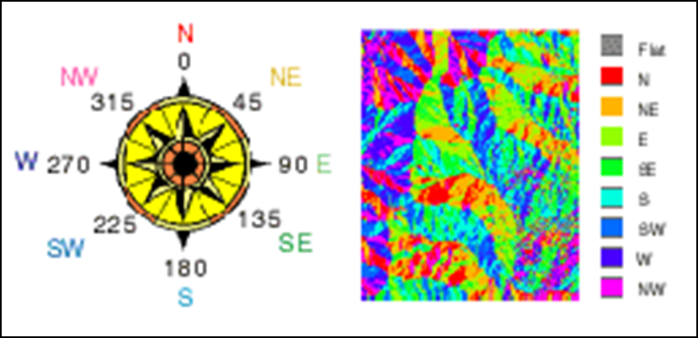
Aspect function
Calculates direction of steepest slope, e.g. which way the slope “faces”. Value represents direction from 0-360 where 0/360 is North. Flat areas are assigned a -1 value.
Where should we install solar panels?

Slide 33
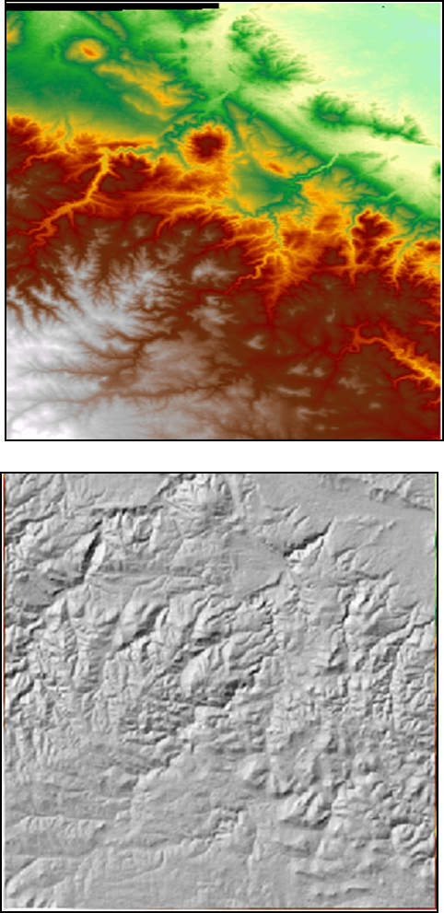
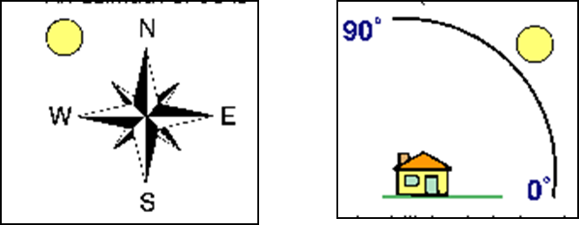
Hillshade
Calculates the brightness or illumination of a surface from a specified light source.
Applications include terrain display and modeling satellite reflectance.
Azimuth is direction of illumination source (315 by default)
Altitude is the angle of the source above the horizon (45 deg)

Slide 34
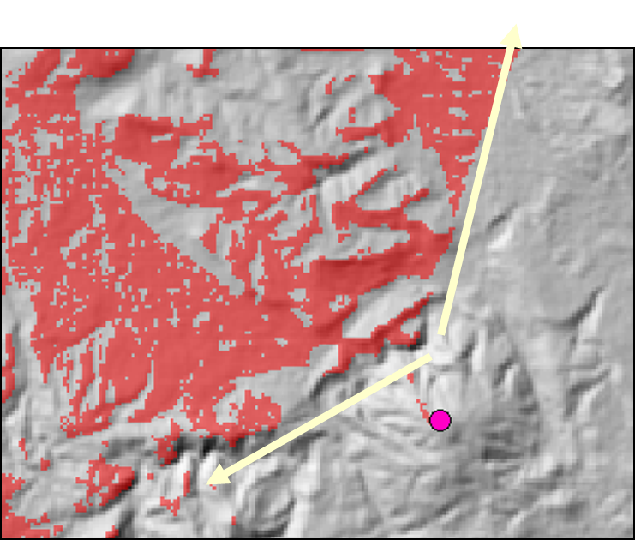
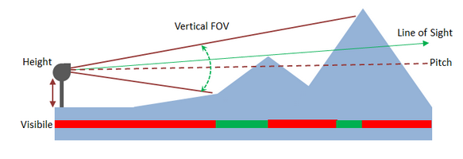
Viewshed analysis
Calculate areas visible from a set of observation points
Why is it difficult to get cell phone reception in some areas?

Slide 35
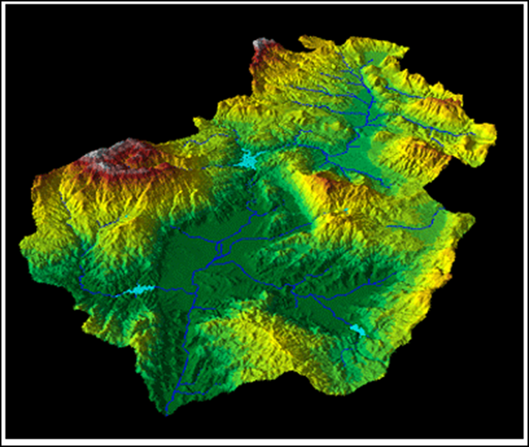
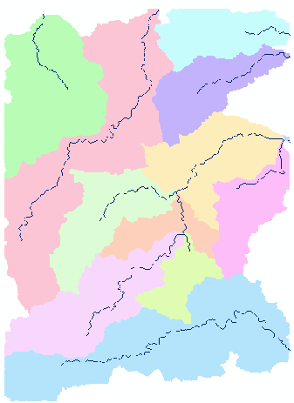
Hydrologic functions
Derive streams, watersheds, and other hydrologic features based on analysis of a DEM.

Slide 36
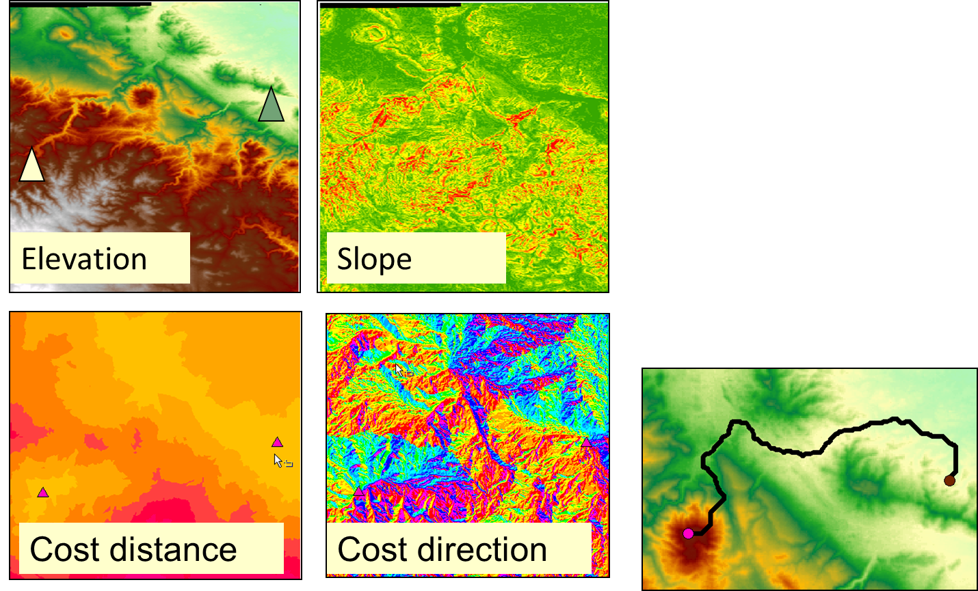
Distance functions: Lowest cost path
Create start/stop shapefiles
Create cost grid
Calculate cost distance grid and cost direction grid
Find lowest cost path

Slide 37
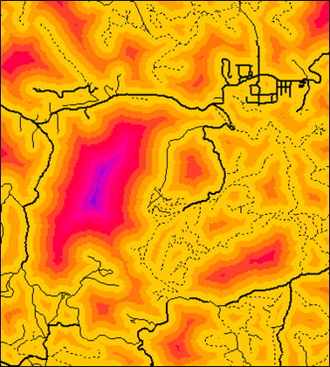
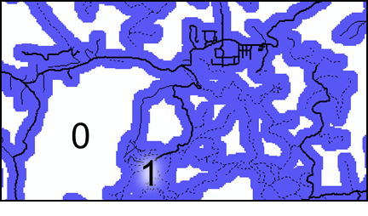
Distance functions: Buffers
Roaddist < 500
Logical expressions easily create Boolean rasters representing buffers from distance rasters.

Slide 38
How do we create a raster of the real-world from scratch?

Slide 39
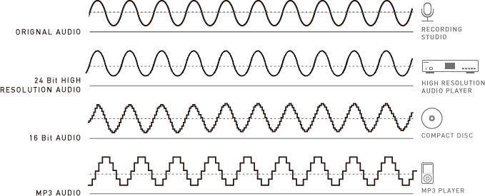
Sampling
What is sampling? A finite number of observations selected from a larger population
The earth and everything on it is comprised of an infinite number of points
It is impossible to capture every aspect of the earth – or even a small landscape – because we cannot take an infinite number of measurements
Therefore, we must measure only what is essential, or practical, or what we can afford
Source: Technics

Slide 40
Geospatial Sampling
Sampled locations should be spaced so the “net” can capture important features
A spatial sampling interval is the average distance between sampled locations
Short interval – more points and more detail
Large interval – fewer points and less detail
The sample interval should be no larger than ½ the size of the smallest detail to be mapped

Slide 41
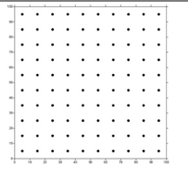
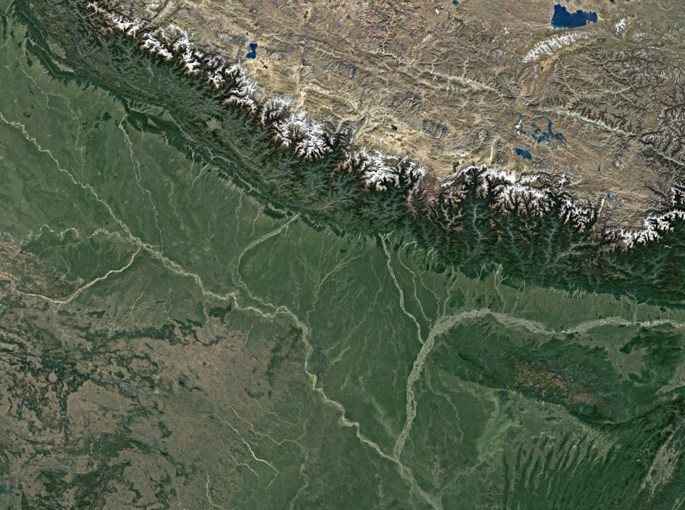
Geospatial Sampling
We can control 2 main aspects of the sampling process
Choose location of samples
Choose number of samples
Systematic sampling pattern
Usually the simplest pattern but it is not always the most efficient. One size does not always fit all.
Works best for homogeneous landscapes

Slide 42
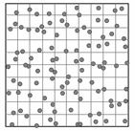
Geospatial Sampling
Systematic random sampling pattern
Random within each grid cell
Sample methods to exploit known natural patterns or features
Cluster of samples can be focused on possible hotspots
Cluster sampling – clusters focused on interest areas
Adaptive sampling – Sample location dependent on landscape (requires knowledge of landscape

Slide 43
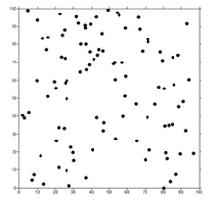
Geospatial Sampling
We can control 2 main aspects of the sampling process
Choose location of samples
Choose number of samples
Random sampling pattern
Grounded in statistical theory, but ignores geography
Rarely used because it is difficult to follow random pattern

Slide 44
Geospatial Sampling
We can control 2 main aspects of the sampling process
Choose location of samples
Choose number of samples
Exploit your knowledge of the landscape to sample more efficiently.
If you have information about the processes that govern the landscape, then you can use that knowledge to help you design a spatial sampling pattern
Also, different layers can be built using different sampling patterns (different layers can be sampled differently)
Hybrid sampling patterns are possible

